Slide 1
UNIT 7
THE WORLD OF WORK
SECTION A- A student’s work (A4)

Slide 2
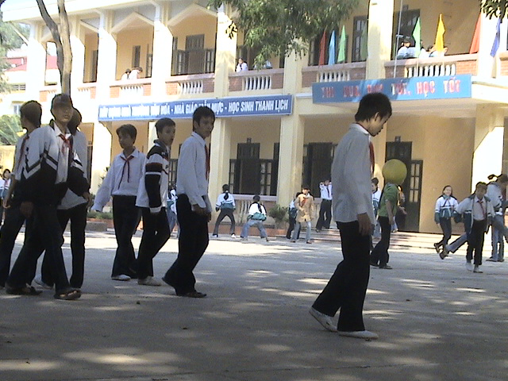
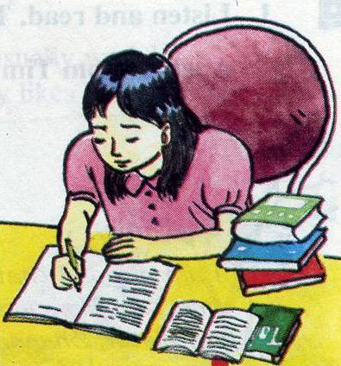
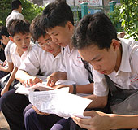
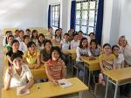

Many people think that students have an easy life.
Do you think so ?
UNIT 7 : THE WORLD OF WORK – A.4
Now take a look at a typical grade 7 student like Hoa.

Slide 3



1. New words:
UNIT 7 : THE WORLD OF WORK – A.4
typical /ˈtɪp.ɪ.kəl/ (adj)
keen /kiːn/ (adj)
lazy /ˈleɪ.zi/ (adj) :
period /ˈpɪə.ri.əd/ (n):
definitely /ˈdef.ɪ.nət.li/ (adv) :
review /rɪˈvjuː/ (v) :
điển hình, tiêu biểu
say mê
lười biếng > < hard-working
tiết học
chắc chắn , nhất định
ôn tập , xem lại

Slide 4





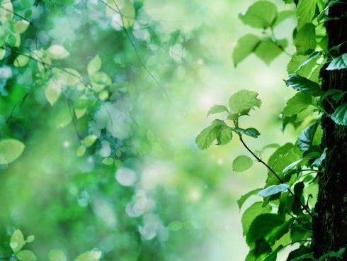
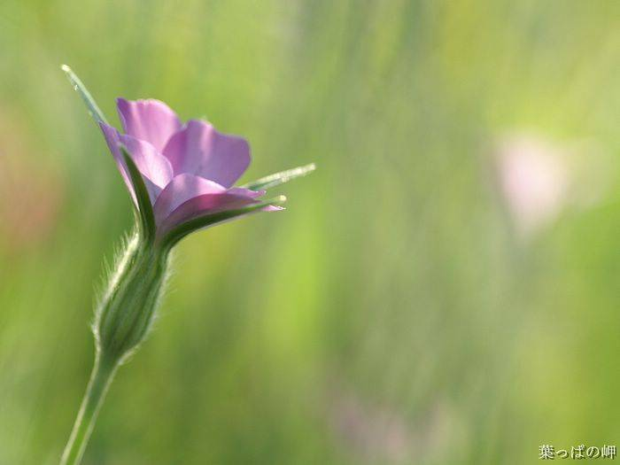




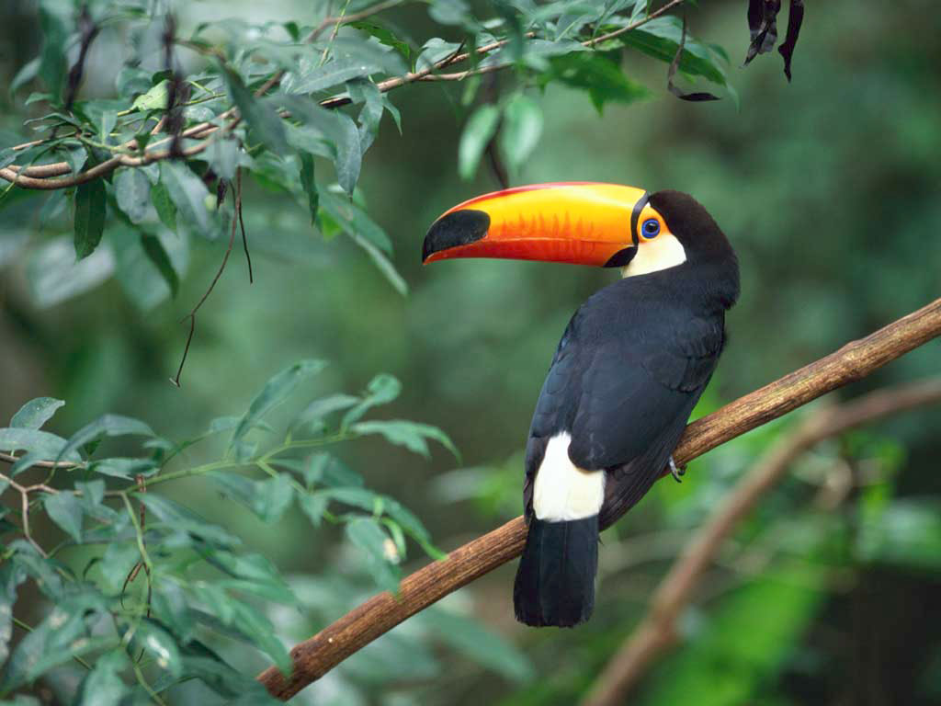


What and where
lazy
lazy
lazy
lazy
keen
keen
keen
keen
typical
typical
typical
typical
definitely
definitely
definitely
definitely
life
period
period
period
review
review
review

Slide 5

2. Read. Then answer the questions.
*Prediction
Guess the amount of time Hoa spends on her work
Hoa has periods a day.
She goes to school days a week.
She works hours a week.
She has about hours of homework every week.
She works about hours a week before tests.

Slide 6

UNIT 7 : THE WORLD OF WORK – A.4
2. Read. Then answer the questions (A4- P.75).
Many people think that students have an easy life: We only work a few hours a day and have long vacations. They don’t know we have to work hard at school and at home.
Take a look at a typical grade 7 student like Hoa. She has five periods a day, six days a week. That is about 20 hours a week - fewer hours than any worker. But that is not all. Hoa is a keen student and she studies hard. She has about 12 hours of homework every week . She also has to review her work before tests. This makes her working week about 45 hours. This is more than some workers. Students like Hoa are definitely not lazy!

Slide 7
*Check the prediction.
Hoa has periods a day.
She goes to school days a week.
She works hours a week.
She has about hours of homework every week.
She works about hours a week before tests.
5
6
20
12
45

Slide 8
Answer the questions :
UNIT 7 : THE WORLD OF WORK – A.4
a. Why do some people think that students have an easy life ?
b. How many hours a week does Hoa work at school?
Is this fewer than most workers ?
c. How many hours a week does she work at school and at home?
d. Does the writer think students are lazy?
Because they only work a few hours a day and have a long vacations .
Hoa works 20 hours a week . It is fewer than most workers.
Hoa works about 45 hours a week.
No, he doesn’t / No, she doesn’t.

Slide 9

UNIT 7 : THE WORLD OF WORK – A.4
3. Model sentences:
- We only work a few hours a day.
- I want to drink a little milk.
Notes :
- a few + N (đếm được số nhiều )
- a little + N ( không đếm được)

Slide 10
Complete the sentences with a little or a few :
a. There is …………… orange juice in the glass.
b. I have …………… books in English.
c. She eats ……………… fruit for breakfast.
d. They will have ………… milk every day.
e. We need ……………… vegetables for lunch.
f. He can buy ……………… apples.
a little
a few
a little
a little
a few
a few

Slide 11
Gap - fill:
UNIT 7 : THE WORLD OF WORK – A.4
Many people …………. that students only work a ……….. hours a day.
Hoa has ………..classes a day, ……… days a week.
She is a ………. student and she works ………
She does her ………………..about ….. hours a week.
She has to ……………. her work before ……… .
think
few
five
six
keen
hard
homework
12
review
test

Slide 12
Ask and answer about you :
UNIT 7 : THE WORLD OF WORK – A.4
How many days a week do you go to school ?
How many periods do you have a day ?
How many hours do you do your homework each day ?
How many hours a week do you work ?
Is that more or fewer hours than Hoa ?

Slide 13

HOMEWORK :
Review all language contents.
Do exercises.
Prepare: Unit 7 (cont) - B.1

